Slide 1
Early Detection of Issues in New Car Models using Natural Language Processing on Customer Call Data
Dilara Ademoglu, 07.11.2022, Final Presentation of Master’s Thesis

Slide 2
Outline
Motivation
Research Questions
Background
Topic Modeling
Datasets
Methodology
Experiments
Step 1: Topic Modeling
Step 2: Text Similarity
Step 3: Visualizations & Front-End
Evaluation Results

Slide 3



Motivation
Sentiment on the feedback
Tests are conveyed.
Unstructured text data
Generated KPIs
If an incident occurs, the testing must be redone.
BMW Customer Call Data
BMW Production Error Data
Grows rapidly
Prioritization of the incidents could lower costs and improve the vehicle quality of future products.
Analysis by hand requires time and resources
Customer reports potential manufacturing defects
The issues are compared with the known production errors
NLP + Analysis
New issues discovered

Slide 4
Outline
Motivation
Research Questions
Background
Topic Modeling
Datasets
Methodology
Experiments
Step 1: Topic Modeling
Step 2: Text Similarity
Step 3: Visualizations & Front-End
Evaluation Results

Slide 5
Research Questions
1
Which state-of-the-art topic modeling approaches would provide better insight into BMW customer feedback datasets?
2
Which text similarity techniques give better matches between BMW customer feedback datasets?
3
How to support quality control departments with interactive topic visualizations of BMW customer feedback datasets?

Slide 6
Outline
Motivation
Research Questions
Background
Topic Modeling
Datasets
Methodology
Experiments
Step 1: Topic Modeling
Step 2: Text Similarity
Step 3: Visualizations & Front-End
Evaluation Results

Slide 7

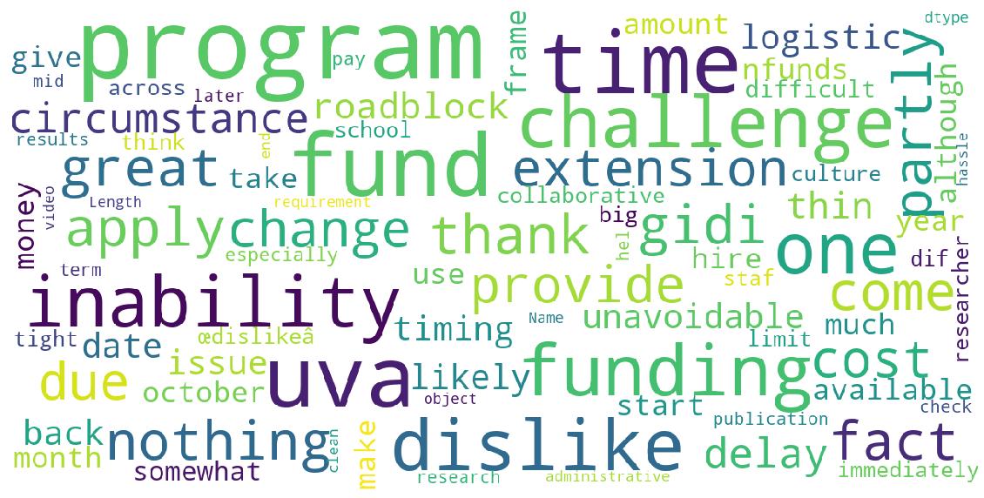

Topic Modeling
Traditional
Embedding-based
Topic 2
Topic 1
Topic Modeling
Algorithm
Topic 3
Collection of Documents
Topic representations / Clusters
Important Parameters:
Extracted words
Number of topic clusters
Topic 1
Number of words per topic
Frequency of words per topic
Image source: https://medium.com/@yulinyu1120/data-visualization-create-aesthetic-word-cloud-with-stylecloud-python-package-9831523a2fe5

Slide 8
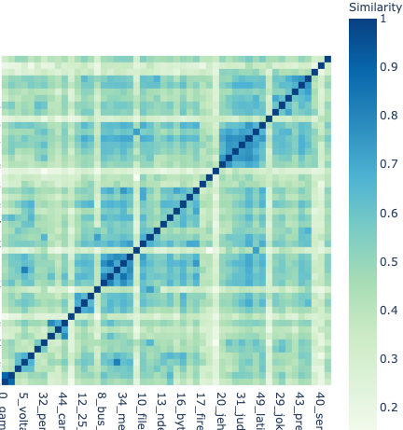
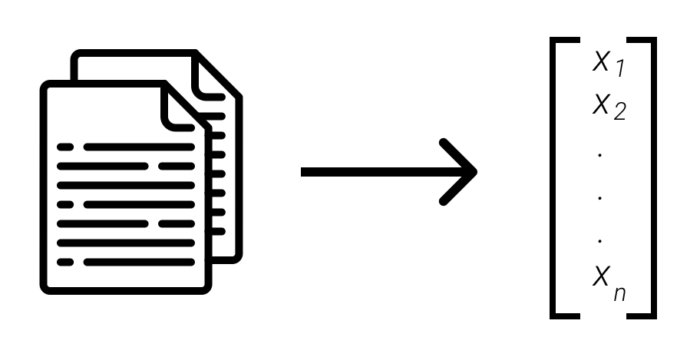
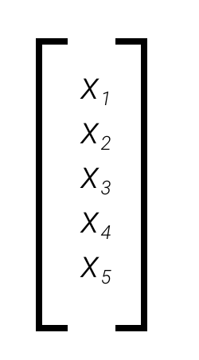
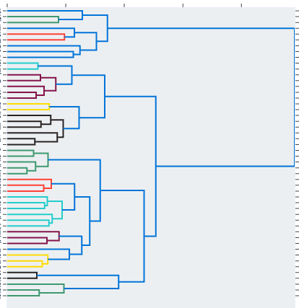
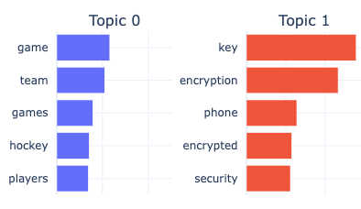
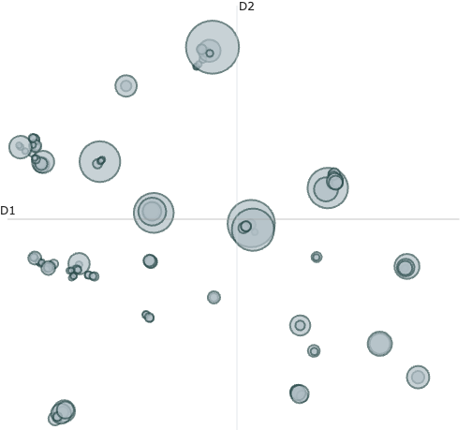



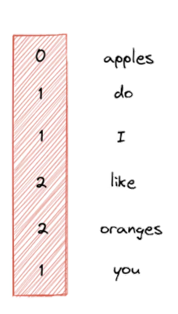
Embedding-based Topic Model
BERTopic
Embed Documents
Reduce Dimensionality
Visualize
Sentence BERT
UMAP
Clustering
Tokenize
Create Topic Representations
Class-based TF-IDF
HDBSCAN
Bag-of-words
[BERTopic] Grootendorst, Maarten. 2022. BERTopic: Neural topic modeling with a class-based TF-IDF procedure.
Image source: https://maartengr.github.io/BERTopic/algorithm/algorithm.html

Slide 9
Outline
Motivation
Research Questions
Background
Topic Modeling
Datasets
Methodology
Experiments
Step 1: Topic Modeling
Step 2: Text Similarity
Step 3: Visualizations & Front-End
Evaluation Results

Slide 10
Datasets
BMW Welcome Call Dataset
Column Name | Description
van_17 | The unique anonymized vehicle identifier. (text)
call_date | The date of the call. (timestamp)
category | Hand-labeled category of the customer feedback. (text)
customer_feedback | The transcripted customer feedback text. (text)
feedback_type | Labeled type of feedback, four categories available: Likes, Difficult to Use, Wants, Defects. (categorical)
production_series | The model name during the production. (text)
Customer call data.
Number of samples: 236.878
Customer stated he wants a lighter trunk because it’s too heavy.
Customer stated that he feels that the Navigation is hard to read at times.
Customer stated he wanted a UV Sunshade to protect his interior. Writer advised they can be found on the BMW shop site.

Slide 11
Datasets
BMW Problem Quality Management (PQM) Dataset
Column Name | Description
pqm_incident_number | The unique incident identifier. (numeric)
pqm_problem_number | The unique problem identifier. (numeric)
pqm_problem_assignment_date | The date of incident assignment. (timestamp)
pqm_incident_title | The title of the PQM incident. (text)
pqm_incident_description | The description of the PQM incident. (text)
pqm_model_range | The model name during the production. (text)
pqm_problem_title | The title of the PQM problem. (text)
pqm_problem_description | The description of the PQM problem. (text)
Production error data.
Number of samples: 247.608
Incident:
Customer complains about steering wheel being off center respectively car pulling to one side.
Steering wheel not straight.
Front Axle, Steering Wheel misalignment
Problem:
Front Axle, Steering Wheel misalignment and vehicle pulling.

Slide 12
Outline
Motivation
Research Questions
Background
Topic Modeling
Datasets
Methodology
Experiments
Step 1: Topic Modeling
Step 2: Text Similarity
Step 3: Visualizations & Front-End
Evaluation Results

Slide 13
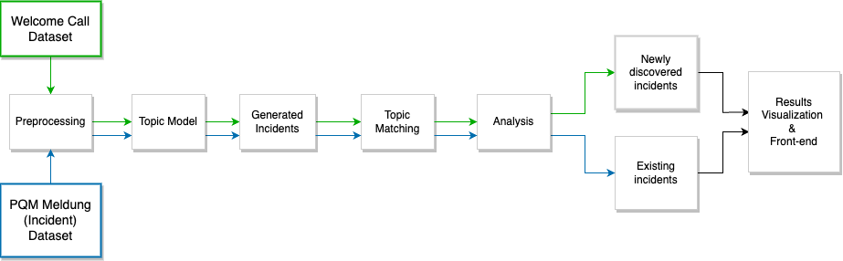
Methodology
Text cleaning, lemmatization,
stop word removal
Welcome Call Dataset
Newly discovered incidents
Results Visualization &
Front-end
Preprocessing
Topic
Model
Generated
Incidents
Topic Matching
Analysis
Existing incidents
PQM Meldung (Incident) Dataset
Step 1
Step 2
Step 3
Step 0

Slide 14
Outline
Motivation
Research Questions
Background
Topic Modeling
Datasets
Methodology
Experiments
Step 1: Topic Modeling
Step 2: Text Similarity
Step 3: Visualizations & Front-End
Evaluation Results

Slide 15
Experiments
Step 1 – Topic Modeling
Number of topic clusters:
50, 75, 100, 125, 150, 250
80, 85, 90, 95
Evaluation:
Intertopic distance maps
Word clouds / topic words
Coherence metric (Umass)
Models:
LDA
BERTopic
Number of topic words:
Top-10 and Top-20
Welcome Call Dataset
Newly discovered incidents
Results Visualization &
Front-end
Preprocessing
Topic
Model
Generated
Incidents
Topic Matching
Analysis
Existing incidents
PQM Meldung (Incident) Dataset
Step 1

Slide 16
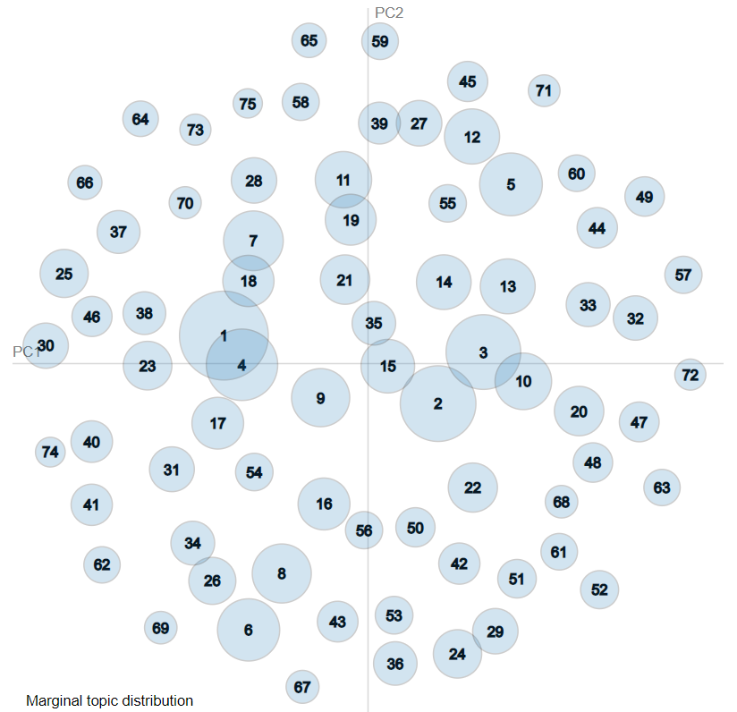
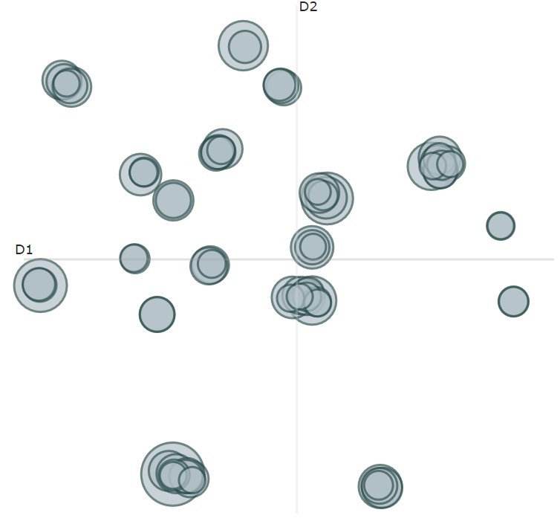

Experimental Results – Topic Modeling
Welcome Call – 75 topic clusters (top-20-words)
 |  | LDA | BERTopic
Intertopic distance map
Topic words: | seat | seat, like, passenger, belt, want, heat, sun, area, higher, leather, sit, easily, material, able, inch, visor, adjustment, easy, acceleration, smoother | seat, row, massage, room, rear, adjustment, leg, passenger, adjust, space, recline, message, second, lock, interior, position, forward, chair, like, child leather, interior, seat, color, upholstery, material, look, stitch, beige, black, jean, like, picture, stain, plastic, white, passenger, cognac, red, clean
Umass coherence score |  | -4.49 | -3.12

Slide 17
Experimental Results
Step 2 – Topic Matching / Text Similarity
Metrics:
Cosine Similarity – with Sentence BERT embeddings
Soft Cosine Similarity – with GloVe
Number of topic clusters:
80, 85, 90, 95
Evaluation:
Precision, Recall, F1 Score
Heatmaps
Number of topic words:
Top-10 and Top-20
Welcome Call Dataset
Newly discovered incidents
Results Visualization &
Front-end
Preprocessing
Topic
Model
Generated
Incidents
Topic Matching
Analysis
Existing incidents
PQM Meldung (Incident) Dataset
Welcome Call model & PQM model pairs
Distance matrix
Similarity Table with labels by topic words
Step 2

Slide 18
Experimental Results – Text Similarity
Analytical Measures – F1 Score
Number of Welcome Call clusters | Number of PQM clusters | F1 Score: Cosine with Sentence-BERT | F1 Score: Soft-Cosine with GloVe
80 | 80 | 0.873 | 0.665
80 | 85 | 0.865 | 0.656
80 | 90 | 0.921 | 0.671
80 | 95 | 0.886 | 0.727
85 | 80 | 0.763 | 0.723
85 | 85 | 0.868 | 0.748
85 | 90 | 0.854 | 0.769
85 | 95 | 0.899 | 0.778
90 | 80 | 0.784 | 0.684
90 | 85 | 0.881 | 0.743
90 | 90 | 0.886 | 0.693
90 | 95 | 0.921 | 0.727
95 | 80 | 0.810 | 0.704
95 | 85 | 0.827 | 0.766
95 | 90 | 0.867 | 0.758
95 | 95 | 0.857 | 0.760
F1 Scores of Cosine vs Soft-Cosine models with top-20 topic words, for 80, 85, 90, 95 topic clusters. 85-95 pair is selected for next step.

Slide 19
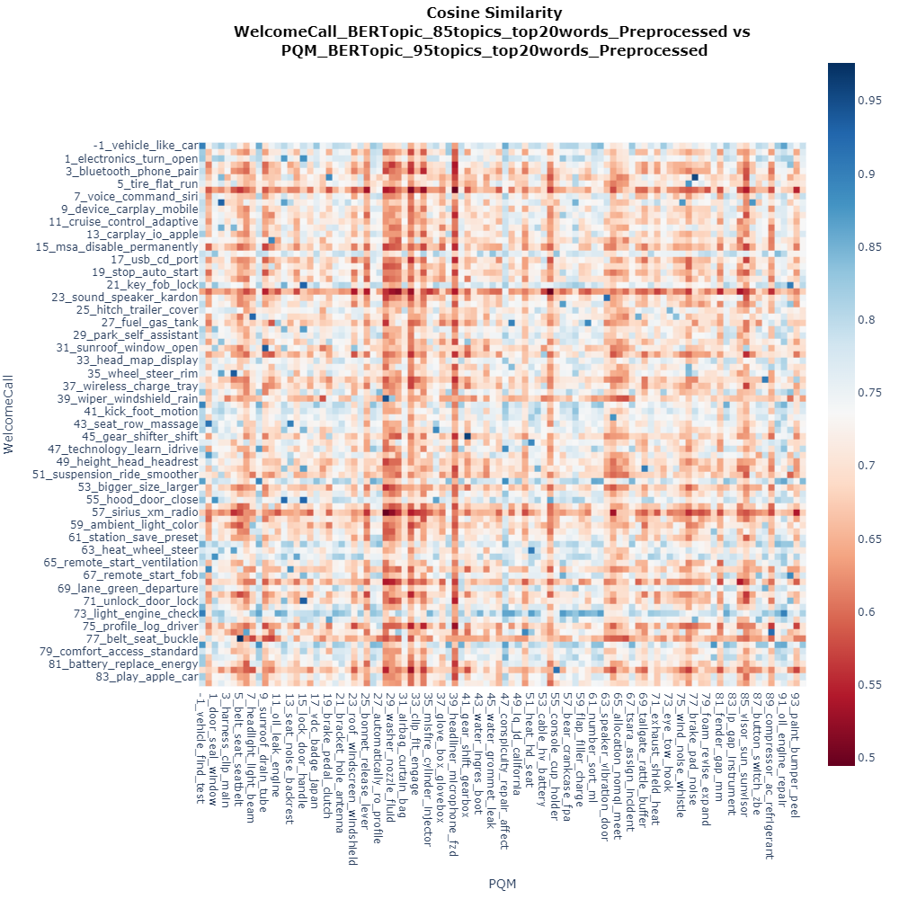
Experimental Results – Text Similarity
Heatmap
Welcome Call 85 topic clusters & PQM 95 topic clusters
Blue = Similar topics
Red = Dissimilar topics

Slide 20
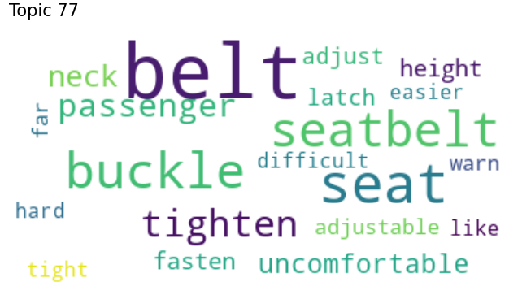
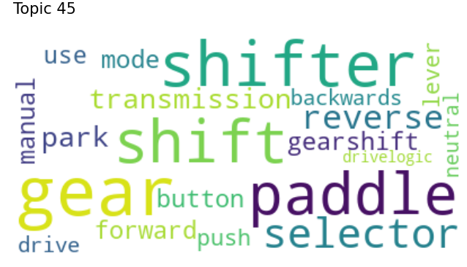
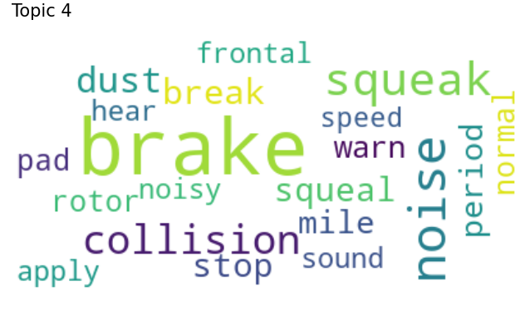
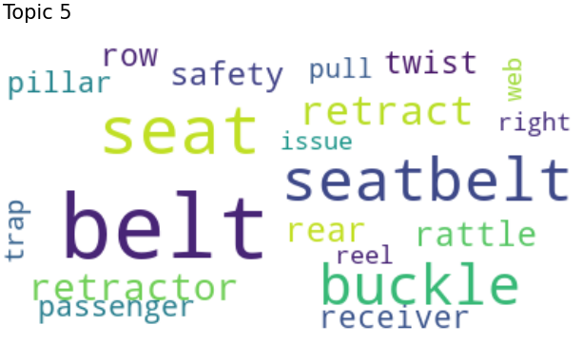
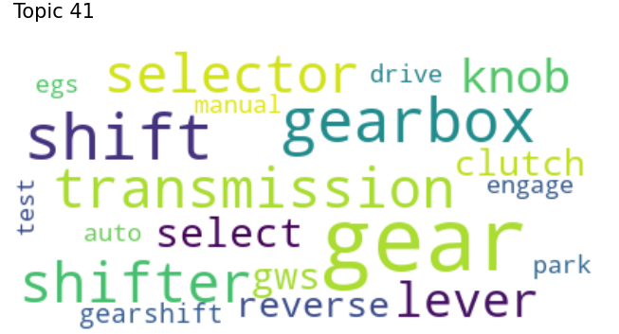
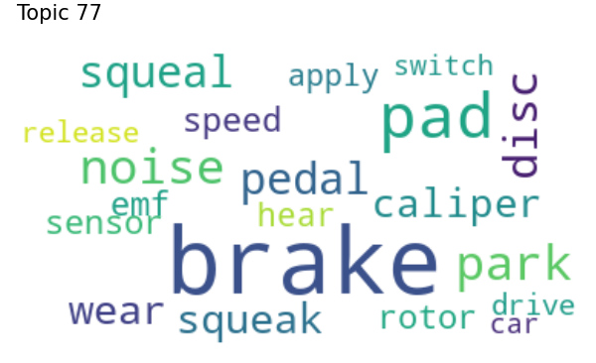
Results
Matched Topics
Match 1
Match 2
Match 3
Welcome Call
PQM
Seatbelt buckle rattling noise, height adjustment
Reverse gear shift in manual/auto transmission
Squeaking noise coming from brakes

Slide 21
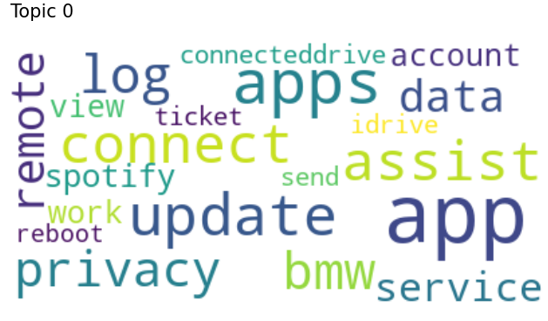
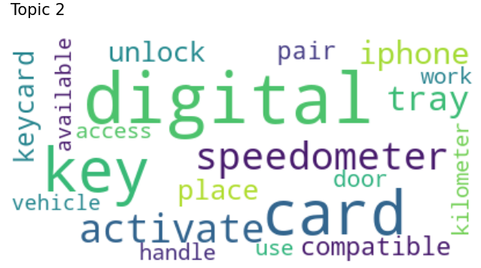
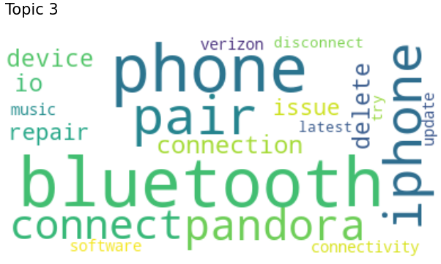
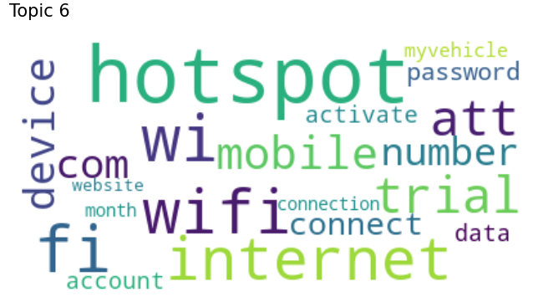
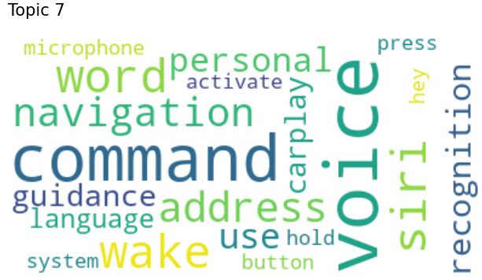
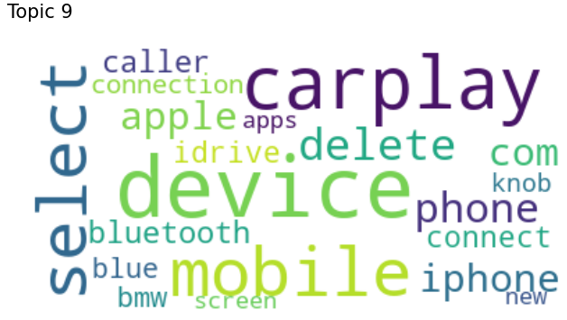
Results
Newly Discovered Issues
Remote app connection, BMW service app assistance
Digital vehicle key card activation
Connection of phone, Bluetooth device pairing
Wifi hotspot connection with mobile device
Personal voice command guidance with navigation system
New mobile device/Iphone Apple carplay connection
47 new issues were found in Customer Call dataset, that does not occur in the production data. (out of 85 topics)

Slide 22
Experiments
Step 3 – Visualization & Front-End
Welcome Call Dataset
Newly discovered incidents
Results Visualization &
Front-end
Preprocessing
Topic
Model
Generated
Incidents
Topic Matching
Analysis
Existing incidents
PQM Meldung (Incident) Dataset
Step 3

Slide 23
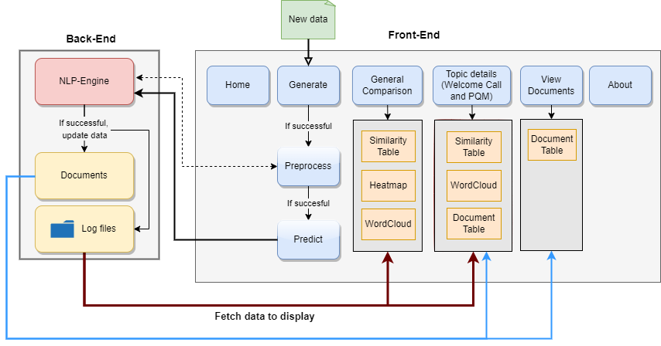
Visualization & Front-End
System Architecture
New data
Back-End
Front-End
NLP-Engine
Home
Generate
General comparison
Topic details
(Welcome Call & PQM)
View Documents
About
If successful,
update data
If successful
Similarity Table
Similarity Table
Document Table
Documents
Preprocess
Heatmap
Wordcloud
If successful
Log files
Wordcloud
Document Table
Predict
Fetch data to display

Slide 24
Outline
Motivation
Research Questions
Background
Topic Modeling
Datasets
Methodology
Experiments
Step 1: Topic Modeling
Step 2: Text Similarity
Step 3: Visualizations & Front-End
System Architecture
Evaluation Results

Slide 25
Results
User Study
User study with 14 statements, 4 aspects.
1-5 scale (Strongly Disagree – Strongly Agree)
Views in General Comparison page are useful:
Table View
Heatmap View
Word Cloud View
Model Comparison Evaluation
User Interface Quality
Website is easy to use.
Appearance of website
Speed of loading results
Topic words of models made sense. – Welcome Call & PQM
Document-wise topic predictions – Welcome Call & PQM
Accuracy of similarity matching
System is helpful to understand relationship between processes
Result Quality
Recommendations
Would they use it?
Would they recommend it to colleagues?

Slide 26
Results
User Study
Model Comparison Evaluation
User Interface Quality Evaluation

Slide 27
Results
User Study
Result Quality Evaluation
Recommendation Evaluation

Slide 28
Results
Research Questions
1
Which state-of-the-art topic modeling approaches would provide better insight into BMW customer feedback datasets?
Embedding-based model BERTopic provides better insights into BMW customer feedback datasets by generating more domain-specific topics than traditional model LDA which generates more general topic representations.
2
Which text similarity techniques give better matches between BMW customer feedback datasets?
Cosine Similarity with contextual embeddings provided better topic matches over Soft Cosine Similarity with pretrained word embeddings.
3
How to support quality control departments with interactive topic visualizations of BMW customer feedback datasets?
Word clouds were useful for interpreting topic quality and representations.
Heatmaps were helpful for inspecting topic similarity.

Slide 29
Thank you for listening!
Prof. Dr.
Florian Matthes
17132
matthes@in.tum.de

Slide 30
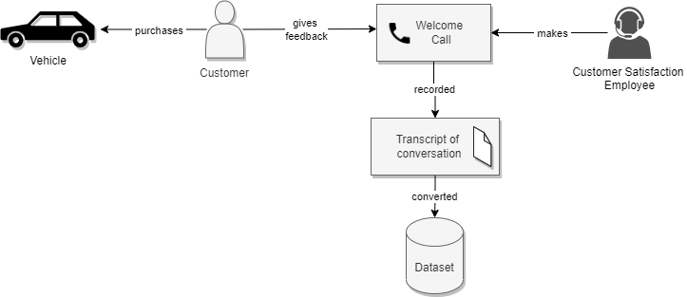
Bonus - Welcome Call Process

Slide 31
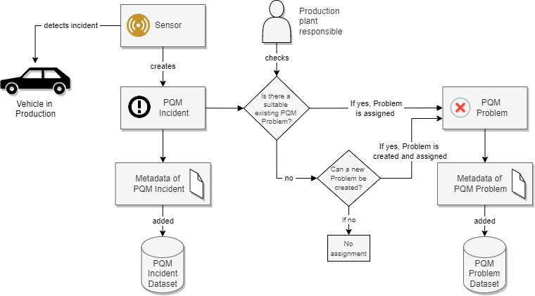
Bonus - PQM Process

Slide 32



Word Embeddings vs. Contextual Embeddings
Word2Vec
GloVe
FastText
Word order is not considered.
Trouble with out-of-vocabulary words.
Word
Embeddings
woman
queen
man
king
Apple prices have increased with the new taxes on the tech industry.
ELMo
BERT
GPT-2
Contextual Embeddings
Vectorizes text, by considering word order of sentences. Current State-of-the-art.
[GloVe] Pennington J., Socher R., and Manning C. 2014. Global Vectors for Word Representation
[BERT] Devlin, Jacob and Chang, Ming-Wei and Lee, Kenton and Toutanova, Kristina. 2018. BERT: Pre-training of Deep Bidirectional Transformers for Language Understanding

Slide 33
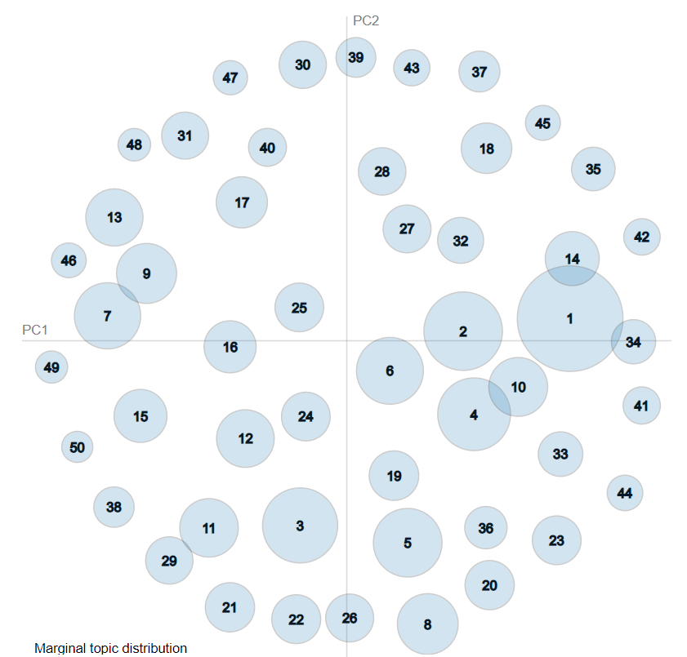
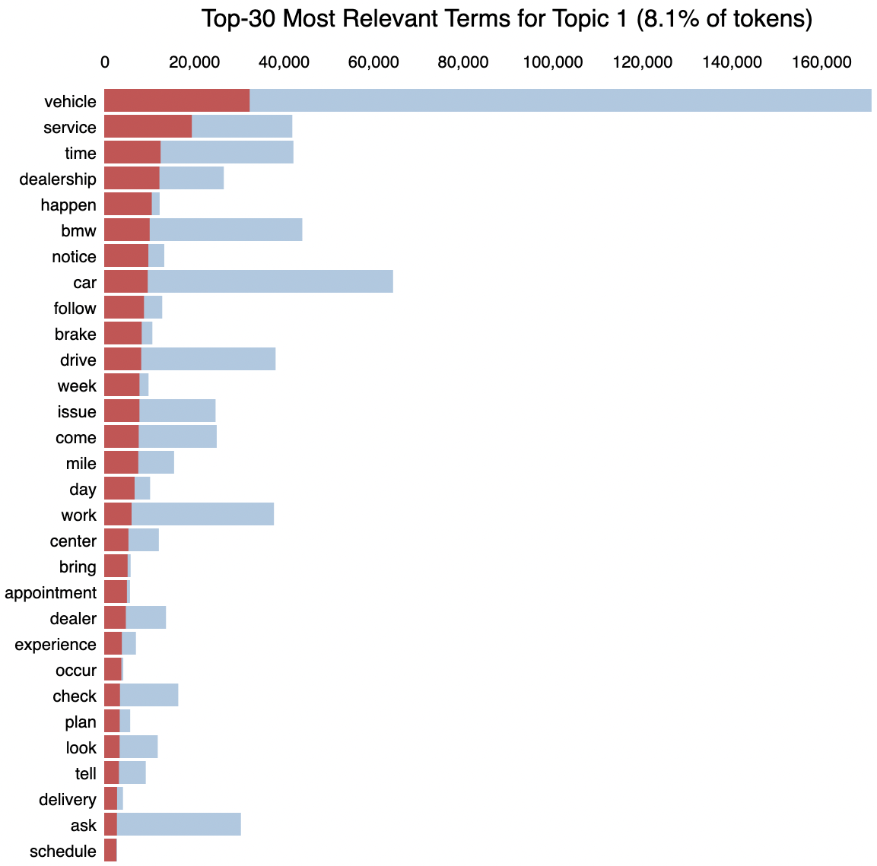
Traditional Topic Model
Bonus – Latent Dirichlet Allocation (LDA)
Number of words in given document
⍺
θ
z
w
Topic representations / Clusters
N
M
Dirichlet parameter
Observed word
Collection of Documents
Document-topic distribution
Number of documents
Word-topic assignment
Frequency of topics per documents
[LDA] Blei, David M. and Ng, Andrew Y. and Jordan Michale I. 2003. Latent Dirichlet Allocation.

Slide 34
Experimental Results – Topic Modeling
Welcome Call – 75 topic clusters (top-20-words)
 |  | LDA | BERTopic
Intertopic distance map
Topic words: | mirror | mirror, automatically, inside, fold, view, stick, switch, like, vehicle, passenger, want, curb, soft, exterior, position, manually, bar, lift, able, countryman | fold, mirror, curb, tilt, passenger, monitor, reverse, automatically, exterior, lock, automatic, switch, position, seat, driver, view, feature, door, deactivate, button
Umass coherence score |  | -4.49 | -3.12

Slide 35
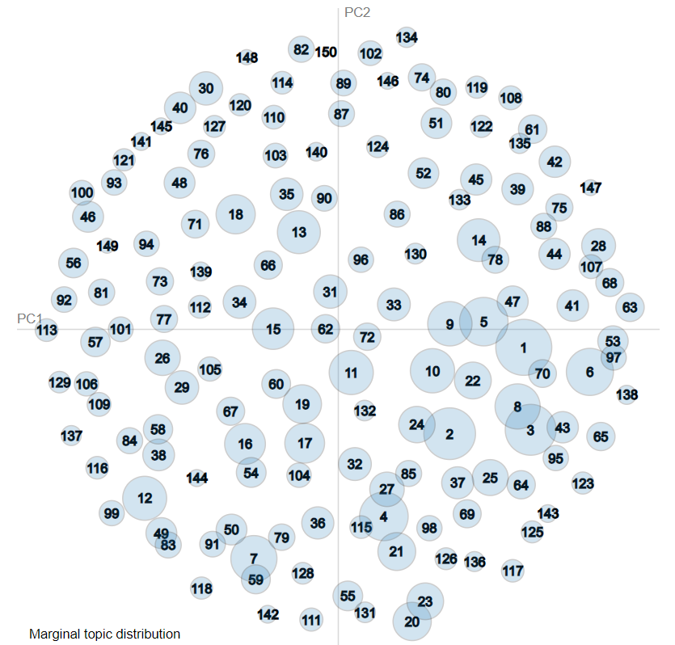
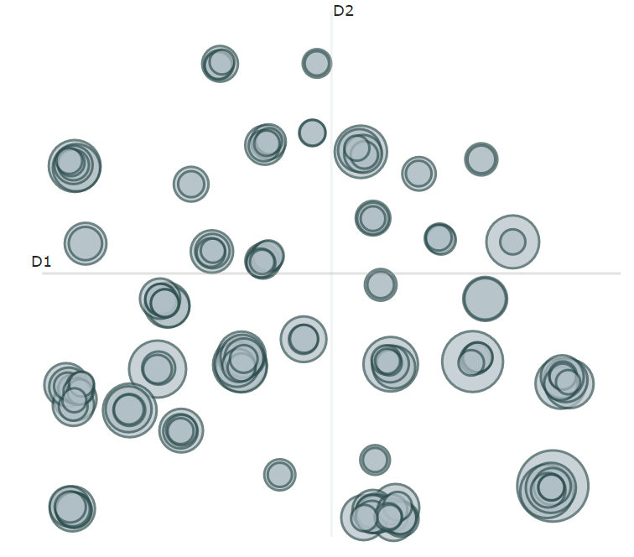
Experimental Results – Topic Modeling
Welcome Call – 150 topic clusters (top-20-words)
 |  | LDA | BERTopic
Intertopic distance map
Topic words: | mirror | mirror, heat, position, utilize, tilt, curb, passenger, resource, slide, like, automatic, briefly, ask, backrest, distribution, vehicle, able, september, use, look | fold, mirror, automatically, lock, exterior, seat, unfold, row, rear, captain, cargo, chair, door, access, button, automatic, manually, want, flat, power mirror, screen, entertainment, android, video, iphone, watch, apple, rear, iphones, compatible, stream, hdmi, miracast, device, use, youtube, carplay, phone, able
Umass coherence score |  | -6.76 | -3.58

Slide 36
Experimental Results – Topic Modeling
Bonus – Analytical Measures – Umass Coherence
The closer Umass score is to zero the better the topic coherence of the model.

Slide 37
Experimental Results – Topic Modeling
Bonus – Analytical Measures – Umass Coherence
The closer Umass score is to zero the better the topic coherence of the model.

Slide 38
Experimental Results – Topic Modeling
Bonus – Analytical Measures – Umass Coherence
Number of topic clusters | LDA – Welcome Call | BERTopic – Welcome Call | LDA – PQM | BERTopic – PQM
50 | -3.82 | -3.07 | -4.05 | -3.06
75 | -4.49 | -3.12 | -4.76 | -3.20
80 | -4.55 | -3.23 | -4.84 | -3.19
85 | -4.73 | -3.18 | -5.23 | -3.35
90 | -5.02 | -3.20 | -5.22 | -3.36
95 | -4.89 | -3.27 | -5.46 | -3.28
100 | -5.11 | -3.33 | -5.64 | -3.44
125 | -6.00 | -3.44 | -6.11 | -3.59
150 | -6.76 | -3.58 | -6.43 | -3.75
250 | -5.05 | -3.79 | -5.60 | -4.52
Umass scores for LDA and BERTopic models with top-20 topic words, for each topic cluster number.
The closer Umass score is to zero the better the topic coherence of the model.

Slide 39
Experimental Results – Text Similarity
Bonus – Similarity Table
Similarity Score | Welcome Call topics | PQM topics | Label | Prediction
0.976 | 77 belt seat buckle seatbelt tighten passenger neck uncomfortable height fasten latch adjust adjustable warn far difficult easier hard tight like | 5 belt seat seatbelt buckle retract retractor rear rattle safety row receiver twist pillar passenger trap pull right web reel issue | Match | Match
0.962 | 45 gear shifter shift paddle selector reverse park transmission forward gearshift mode button manual use lever push backwards drive neutral drivelogic | 41 gear shift gearbox shifter transmission selector lever knob select gws reverse clutch gearshift auto egs engage drive manual park test | Match | Match
0.895 | 52 offer learn assistance question technology decline primary carplay apple genius reach dealership figure moment wife appointment need encore feature assist | 8 repair history conspicuity affect case perception content request sa component german pre entry title comment single perform additional code available | Non-Match | Match
0.892 | 14 fold mirror curb tilt passenger monitor reverse automatically exterior lock automatic switch position driver seat view feature door deactivate unfold | 10 mirror exterior view fold door cap switch glass outside rearview leave triangle base right function driver noise interior adjust rear | Match | Match
0.888 | 66 seat support lumbar thigh comfortable uncomfortable extender leg bolster cushion like wider adjustable sport lever little adjust feel softer extend | 0 seat backrest leather cushion headrest rear armrest crease bolster wavy cover rest audit wrinkle row leave stitch visible gap issue | Match | Match
0.886 | 47 technology learn idrive intuitive offer assistance complicate menu user question friendly decline interface system specific controller wish navigate overwhelm difficult | 47 conspicuity repair affect history case bluetooth period code selective sa cost component country far perception content perform entry single step | Non-Match | Match
0.880 | 64 trim grill kidney piece black grille door fiber carbon loose strip plastic chrome rubber mold seal glare wood passenger rear | 1 door seal window glass frame gap finisher rear panel pillar trim waist guide rubber quarter lh fit chrome rh inner | Non-Match | Match
0.875 | 48 leather seat interior upholstery jean material stitch picture stain look passenger wrinkle cognac clean plastic quality color notice vernasca dealership | 0 seat backrest leather cushion headrest rear armrest crease bolster wavy cover rest audit wrinkle row leave stitch visible gap issue | Match | Match
0.776 | 15 msa disable permanently default feature stop sport turn mode start like function shut auto engine button basis emission trip able | 47 conspicuity repair affect history case bluetooth period code selective sa cost component country far perception content perform entry single step | Non-Match | Non-Match
0.752 | 53 bigger size larger smaller visibility mirror small like little wider rear body view wish style big look screen bite design | 1 door seal window glass frame gap finisher rear panel pillar trim waist guide rubber quarter lh fit chrome rh inner | Non-Match | Non-Match

Slide 40
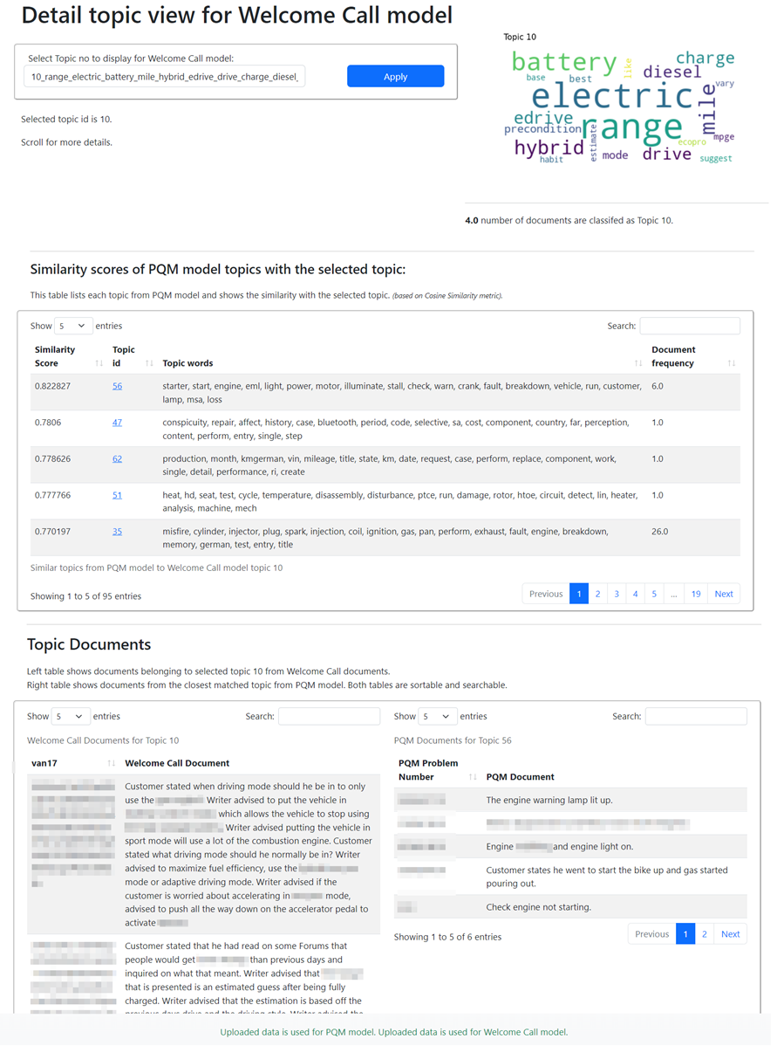
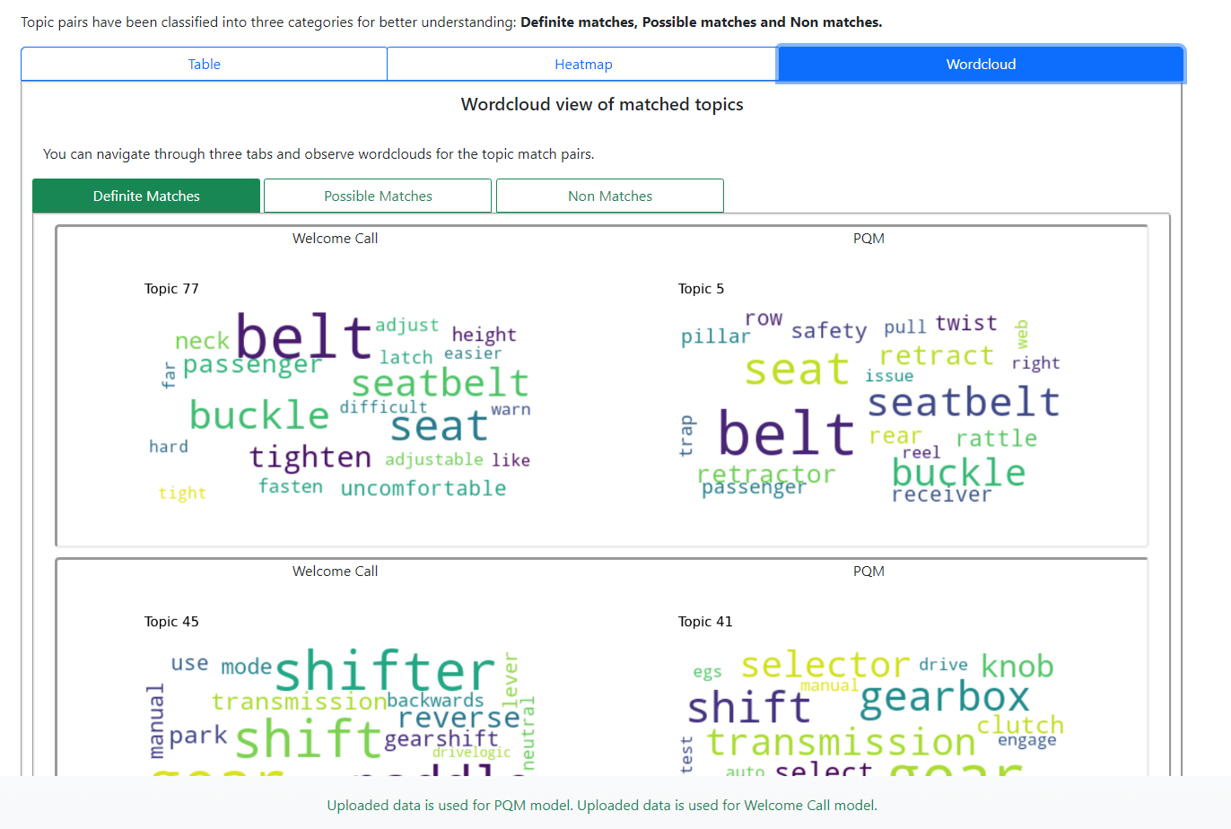
Results
Bonus – Front-End

